Slide 1
Literary Devices: Interesting when you read, useful when you write!

Slide 2
ALLITERATION
is the repetition of the same sound at the start of words.
Examples:
Peter Piper picked a peck of pickled peppers. Sally sells seashells by the seashore.

Slide 3
Assonance + Consonance
Assonance - takes place when two or more words, close to one another repeat the same vowel sound, but start with different consonant sounds.
“On a proud round cloud in a white high night”
Consonance – repetition of consonants with different vowel sounds
“The lint was sent with the tent and Brent.”

Slide 4
ALLUSION
is a casual reference to a famous historical or literary figure or event.
Examples:
If it doesn’t stop raining, I’m going to build an ark. My sister has so many pets I’m going to call myself Old McDonald.

Slide 5
CLICHÉ
is an expression that has lost its power or originality from overuse.
Examples:
talking a mile a minute quiet as a mouse easy as pie

Slide 6
EUPHEMISM
a polite word or phrase used in place of one that may be too direct, unpleasant, or embarrassing.
Examples:
pass away = die vertically challenged = short
let go = fired
pre-owned = used

Slide 7
HYPERBOLE
is an obvious exaggeration or overstatement.
Examples:
I’m so hungry I could eat a horse!
He was so fast he could outrun a Cheetah!

Slide 8
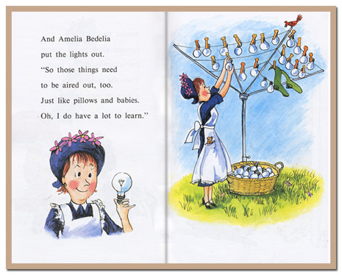
IDIOM
is an expression with a meaning different from the literal meaning of the words.
Examples:
I got cold feet before my speech =
I was scared my boss gave me the green light =
my boss said yes
draw the curtains =
close the curtains
put the lights out =
turn off the lights

Slide 9
IMAGERY
is when a writer invokes the five senses using descriptive language
Examples:
The smell reminded him of disgusting rotting tomatoes.
The familiar tang of his grandmother’s cranberry sauce reminded him of his youth. The fence was uneven, like baby teeth growing awkwardly in. (also a simile!)

Slide 10
METAPHOR
is a comparison of two unlike things without using the words “like” or “as”.
Examples:
He was a statue, waiting to hear the news.
He was a tank on the football field. She was a mother hen, trying to take care of everyone around her.

Slide 11
ONOMATOPOEIA
is a word that imitates the sound it represents.
Examples:
crunch zap tick-tock whoosh
Boom

Slide 12
OXYMORON
two opposite terms used in conjunction.
Examples:
a peaceful war a generous cheapskate dark sunshine
Jumbo shrimp

Slide 13
PARADOX
reveals something that may be true which at first seems contradictory.
Examples:
When you win all the time, you lose.
There is only one rule: there are no rules.

Slide 14
PERSONIFICATION
is when a writer gives human qualities to animals or objects.
Examples:
My car drank the gasoline in one gulp. The cat laughed. The newspaper headline glared at me.

Slide 15
PUN
is a humorous play on words, often involving double meanings
Examples:
When a clock is hungry it goes back four seconds.
A man stole a case of soap from the corner store. He made a clean getaway.

Slide 16
SIMILE
is an expression comparing one thing to another using the words “like” or “as”.
Examples:
He ran like a cat, lightly and quietly. Her blue mood passed as quickly as an afternoon rain shower.

Slide 17
SYMBOLISM
use of symbols to signify ideas and qualities, by giving them symbolic meanings that are different from their literal sense
Examples:
Pink - the fight against breast cancer The Statue of Liberty - freedom

Slide 18
Two goals:
Identify
Use

