Slide 1
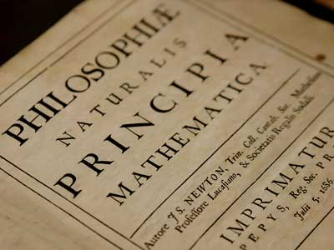
The Enlightenment
Voltaire, Rousseau, Montesquieu

Slide 2
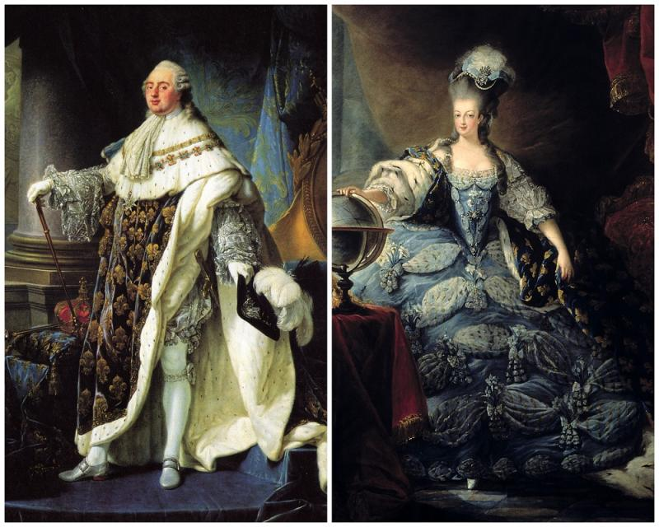
Louis XVI and Marie Antionette
Louis XVI became king in 1774. He had married Marie Antoinette at the age of 15 in 1770.
He was not very interested in running a country… he inherited many problems from previous kings.

Slide 3
Louis XVI:
Born in 1754 in the Palace of Versailles
Became King at age 20
An astrologer warned him to always be on his guard on the 21st day of every month. He died on January 21, 1793.
Loved locksmithing
Known to be immature and lacked self-confidence
When he became King, France already had serious problems
Only king of France to be executed
Was a homebody who loved reading.

Slide 4
Marie Antoinette:
https://www.youtube.com/watch?v=pGPmXQDQi90
Born in Vienna, Austria, in 1755, Archduchess Marie Antoinette was the 15th and last child of Holy Roman Emperor Francis I and the powerful Habsburg Empress Maria Theresa.
Maria Antonia
Executed and body was buried in an unmarked grave
Accused of molesting her son (incest)
Quite a taste for luxury
Nicknamed Madam Deficit because many blamed her for the financial ruin of France
A fairy tale “rustic village” was built for her at the Palace of Versailles
Was taught French by a tutor and immersed in French culture
Last words were ‘pardon me sir, I meant not to do it’ after tripping over the executioner’s toe
Never actually said “Let them eat cake”

Slide 5
Both
Their marriage had been designed to cement the alliance between France and Austria (political reasons)
They were second cousins
They were married for 22 years
Dressed as bakers to attempt an escape from the French Revolution
It took 7 years to consummate their marriage
Had no interest in running the country, but loved spending money

Slide 6
What was the enlightenment? How can we make an educated guess based on these definitions?
Enlightenment: the state of being enlightened.
Enlightened: having or showing a rational, modern, and well-informed outlook.

Slide 7
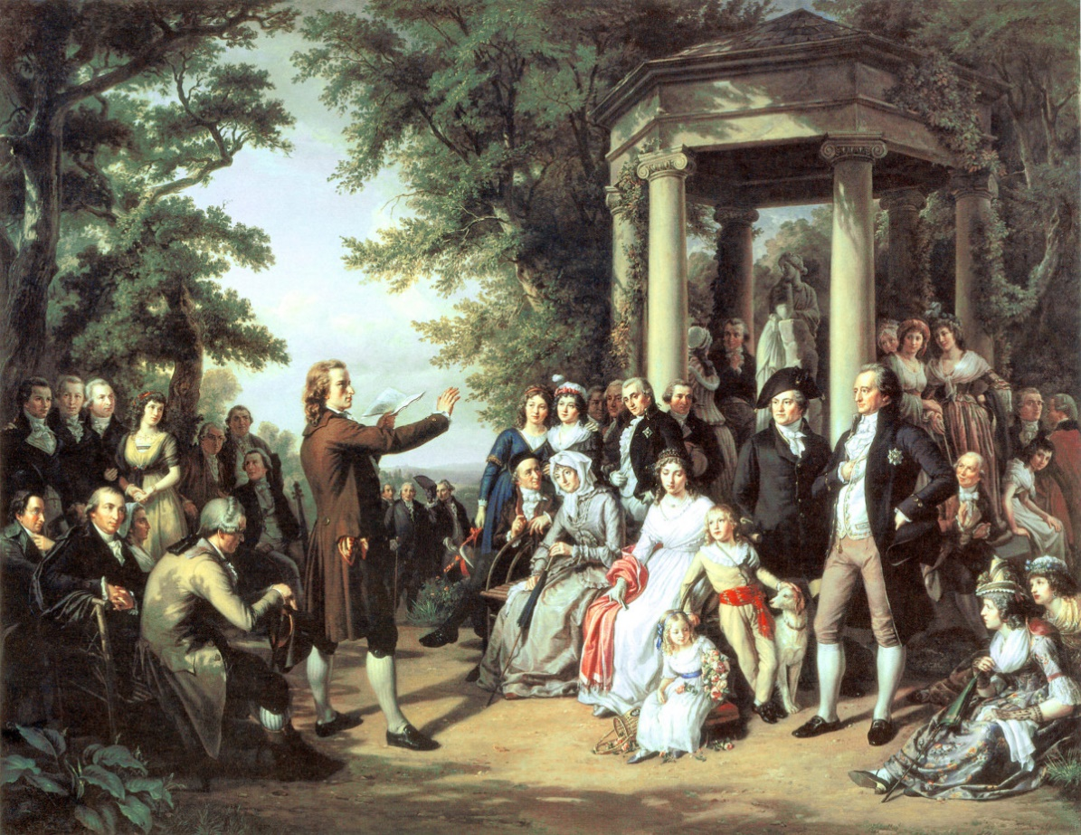
The Enlightenment
Also known as “The Age of Reason”
A philosophical movement + spread of ideas – primarily in Europe
From 17th to late 18th century (1600’s-late 1700’s)
Enlightenment thinkers challenged / questions traditional authority
Aimed to improve humanity though rational change
Helped to inspire the American and French Revolutions
https://www.history.com/topics/british-history/enlightenment

Slide 8
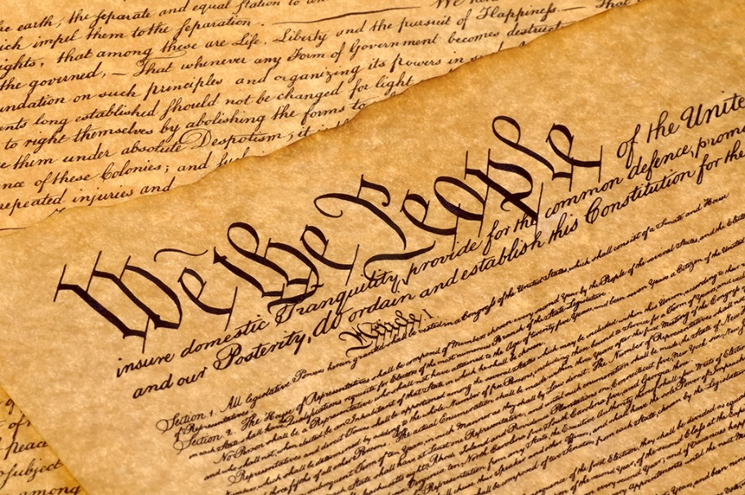
New Ideas
The revolution took place at a time when many new ideas about society were being published and discussed
Many of these new ideas can from philosophes (thinkers) who met to discuss society and politics and solutions to social problems
These ideas were the catalyst for the revolution
Many rejected the idea of absolute monarchy and favoured democracy, which had been won in both Britain and after 1776 in the USA
They also believed in science and scientific reasoning to explain the world

Slide 9
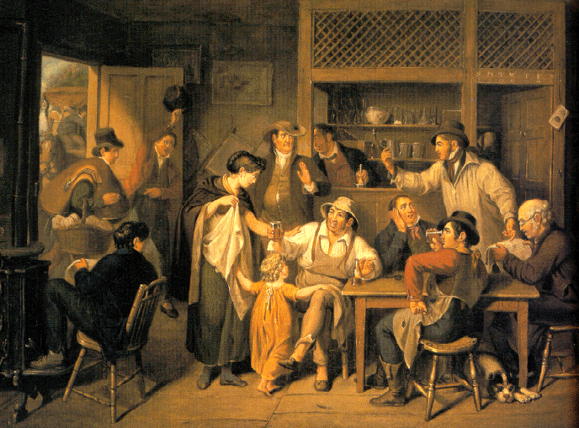
Women & New Ideas
Women were especially important for the spread of new ideas
They held salons where ideas about society, religion and government could be freely exchanged
In a male-dominated society, women served as the hostesses, decided the agenda of topics to be discussed, and regulated the conversation

Slide 10
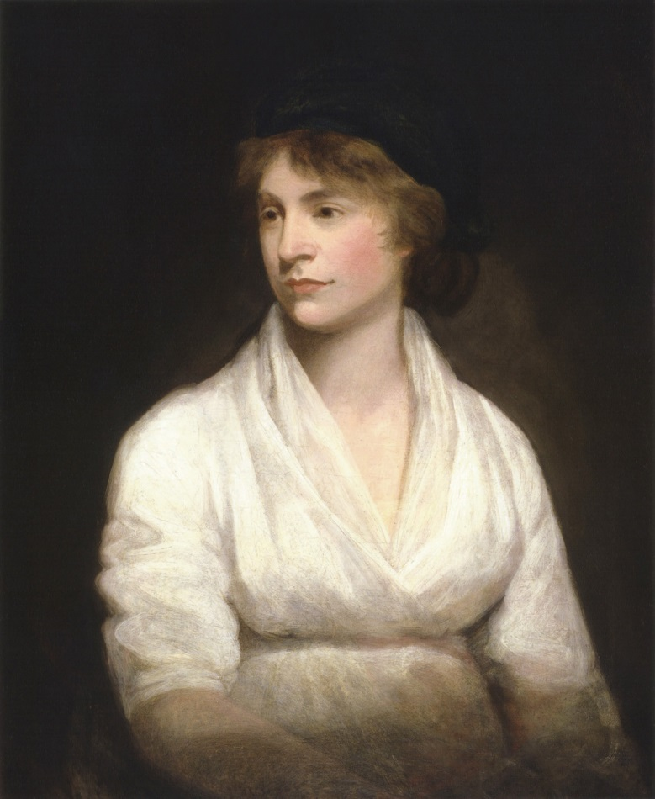
Rights of Women
Ideas about rights of women were circulating through Europe
Works of English Writers, such as Mary Astell and Mary Wollstonecraft, had an influence on France

Slide 11
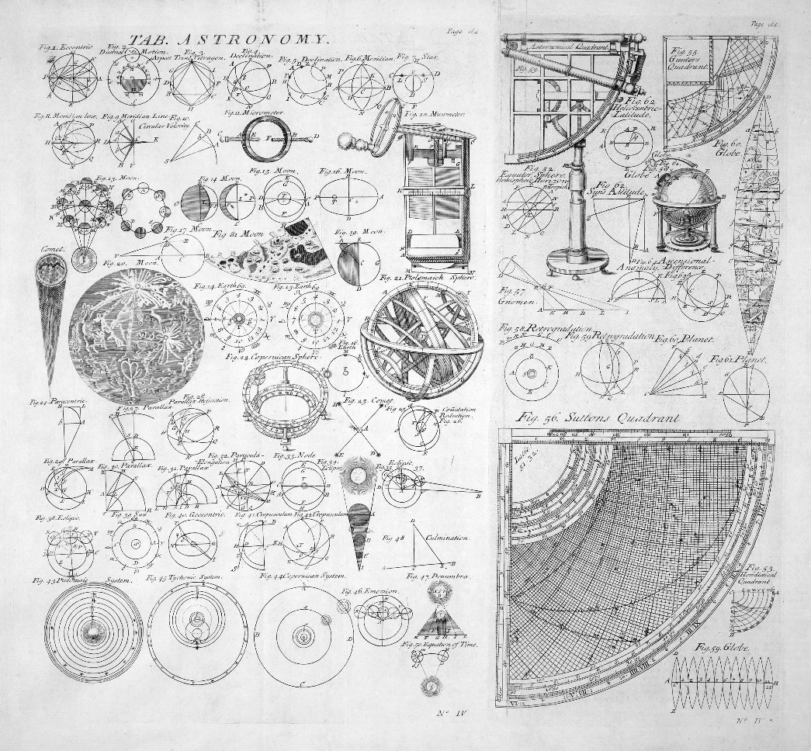
New Ideas about Science
Enlightenment: meant that science and human intelligence were at the highest importance
If a believe could not stand up to reason or it could not be demonstrated by experiment, then it had to be discarded
What does this go against?

Slide 12
Conflict with the Church
It is easy to see how philosophers came into conflict with the Church and refused to accept its teachings
The Church on the other hand supported the country’s rulers (why?)
To many philosophers the Church and the monarchy were holding up progress… they either had to change or go!

Slide 13
Enlightenment Thinkers
We are going to look at 4 important “enlightenment thinkers”:
John Locke
Montesquieu
Rousseau
Voltaire

Slide 14
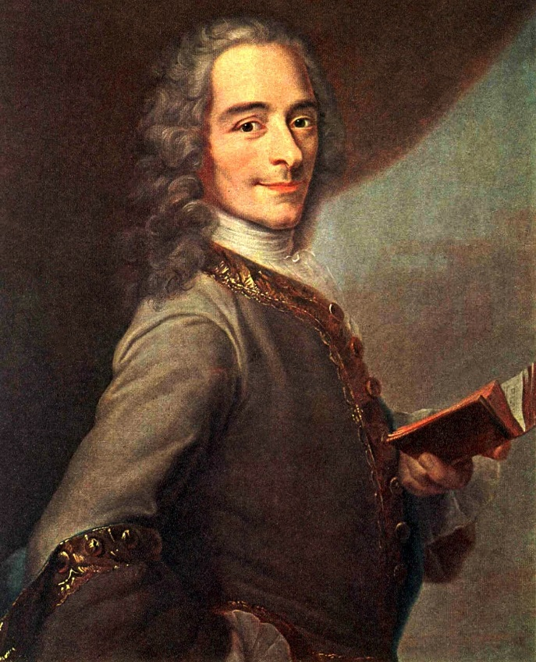
John Locke
Believed in 3 natural rights for humans:
Life, Liberty, and Property
People are capable of knowing when these rights are violated
Should be laws in place to protect these rights.
The role of government should be to protect citizens 3 natural rights

Slide 15
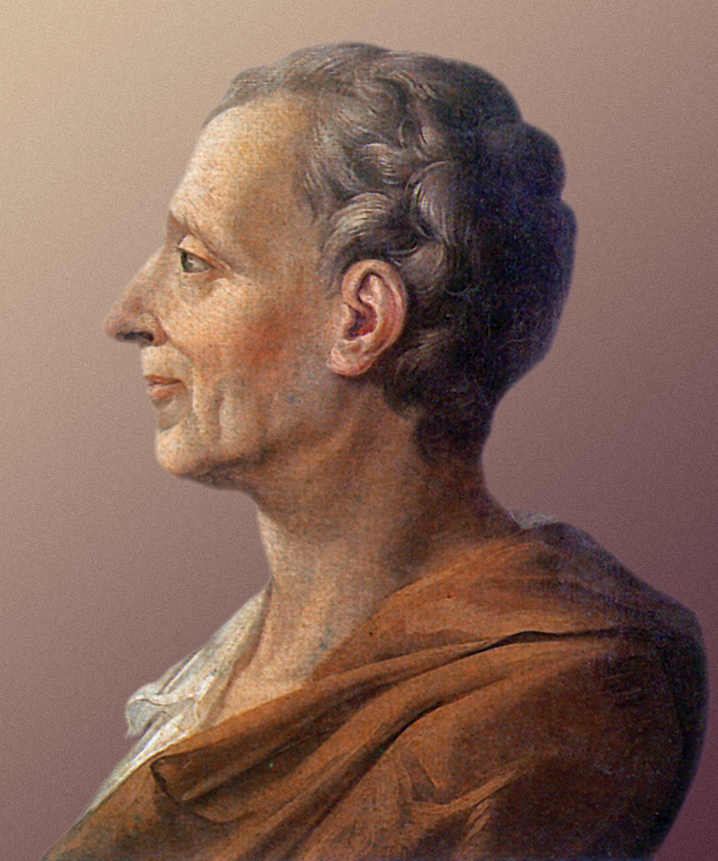
Montesquieu
Separation of power in government
He believed that a ruler and elected officials should hold separate powers
Government power should be divided into 3 sections:
Executive, Legislative, and Judicial
This way no one person or group could hold too much power
Each branch keeps the other in check

Slide 16
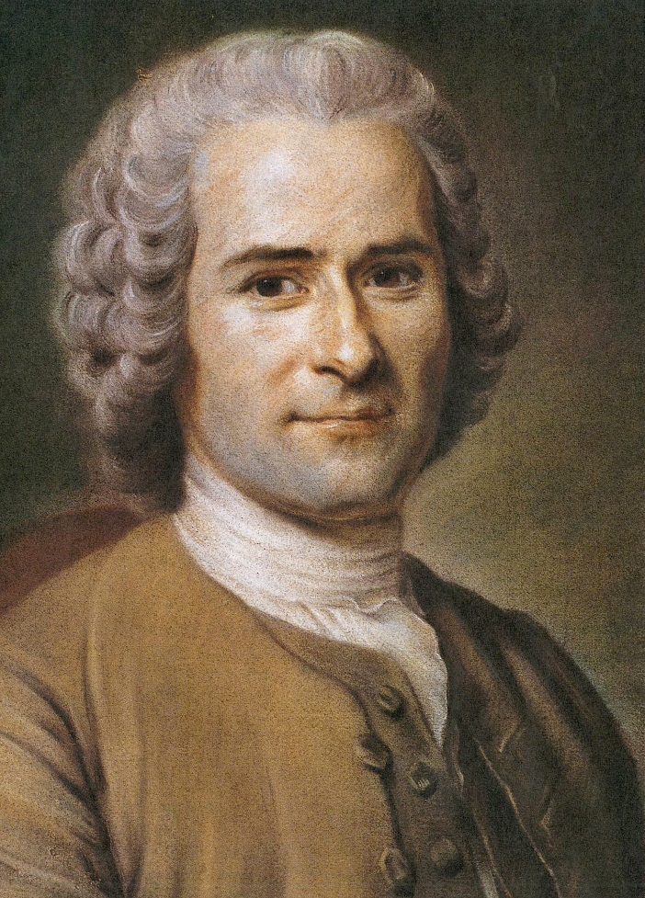
Rousseau
Society needed a social contract with the government where everyone agreed to a set of rules - “Social Contract”
Government has a responsibility to protect its citizens. If it does not, it has broken the contract.
Born in Geneva, Switzerland
His father was a watchmaker
He believed that reason could change people for the better

Slide 17
Voltaire
Believed in the separation of Church and State as well as freedom of thought – Believed in greater tolerance within society
Separation of church and state
Born in Paris
His father was a notary and his mother came from a noble family
He believed that a monarch could rule well if he/she was enlightened
He felt that common people were ignorant and superstitious
He hated injustice and defended people he believed were victims of prejudice

