Slide 1
Review of Political Clubs – Jacobins
Jacobins – The Jacobins became in the course of events the most radical and influential party of the Revolution.
Initially, it was a political club where people gathered to discuss ideas. It was largely comprised of members of the middle-class - businessmen, bankers, lawyers, and other notables. It also had high membership fees and restricted itself to men only, though under Robespierre's leadership, women often attended their meetings in the galleries for public debates
In control during the “Reign of Terror”

Slide 2
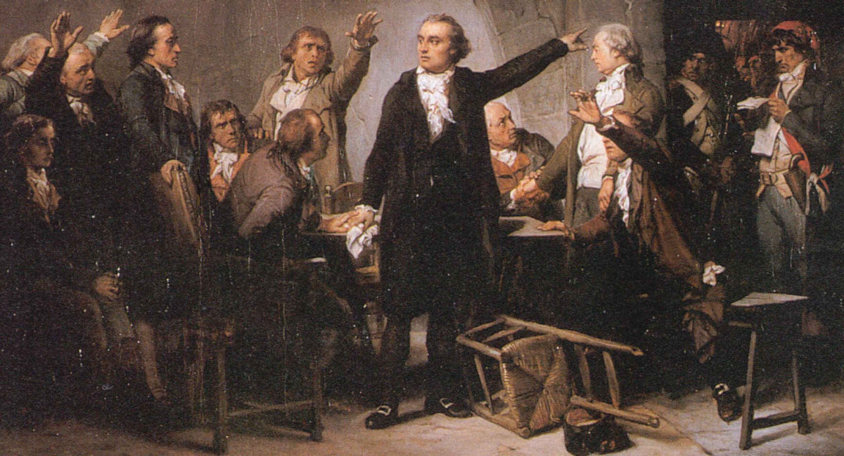
Girondists
The Girondists - favored a government with the capital moved away from Paris while the Jacobins wanted a centralized state. They also proved hesitant to reforms and kept backtracking on the trial of the King
Were more moderate than the Jacobins
May-June 1793 - the arrest, trial, and execution of its leaders and the first major purge of the Revolution

Slide 3
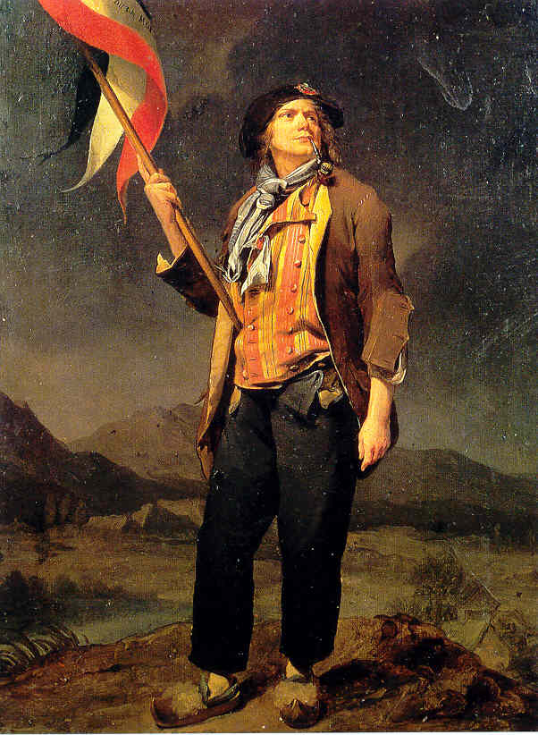
Sans-Culottes
"without breeches“ (based on how they dressed)
Mostly poor population from Paris.
Against any reform that would help the bourgeoisie
Very violent, formed many of the groups that rioted in the streets
Led by Jean-Paul Marat
Executed a leader of the Girondists

Slide 4
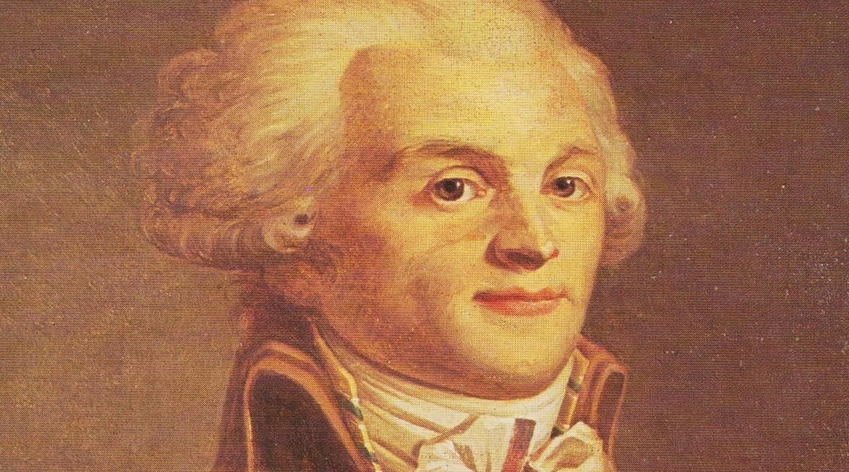
“Terror is only justice: prompt, severe, and inflexible; it is less a distinct principle than a natural consequence of the general principle of democracy, applied to the most pressing wants of the county.”
Robespierre
on justifying the use of terror against “enemies,” of the republic.
What do you think this quote means?

Slide 5
The Reign of terror
And FALL of Robespierre

Slide 6
The king is dead
The execution of Louis led to a new stage in the Revolution
His execution was ordered by the NEW GOVERNING BODY – The National Convention
France was declared a Republic by the Jacobins/sans-culottes and the slogan was “Liberty, Equality, Fraternity”
The moderates (people who wanted change but did not hold extreme or radical opinions) were now seen as ENEMIES of the revolution.
Girondists were imprisoned…. France was essentially being run by a dictatorship.

Slide 7
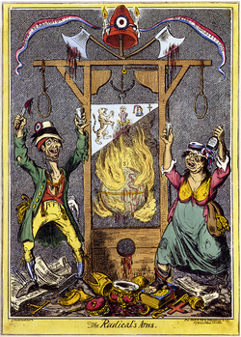
Reign of Terror Begins
From 1793-1794 the government was controlled by the Committee of Public Safety
Maximilien de Robespierre was the leader
Many laws were passed to fear monger citizens:
If you were unable to produce citizenship papers you were arrested and executed
Anyone of noble family or who held office previously could be arrested
Food speculators were guillotined

Slide 8
The Guillotine
Introduced into France in 1792
A guided blade, weighted heavily on the top/back
Joseph Guillotin.. Largely contributed to passing a law in 1789 that required all sentences of death to be carried out by means of a machine
Equal death sentence for everyone. Painless
Last use in France was in 1977

Slide 9
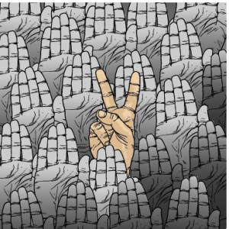
The Good?
Many ordinary people were able to participate in politics for the first time
Primary education became free
Government granted public assistance for the poor, price controls, and taxes
Call for abolishing slavery in France’s colonies
However…. Most of these were never fully carried out…

Slide 10
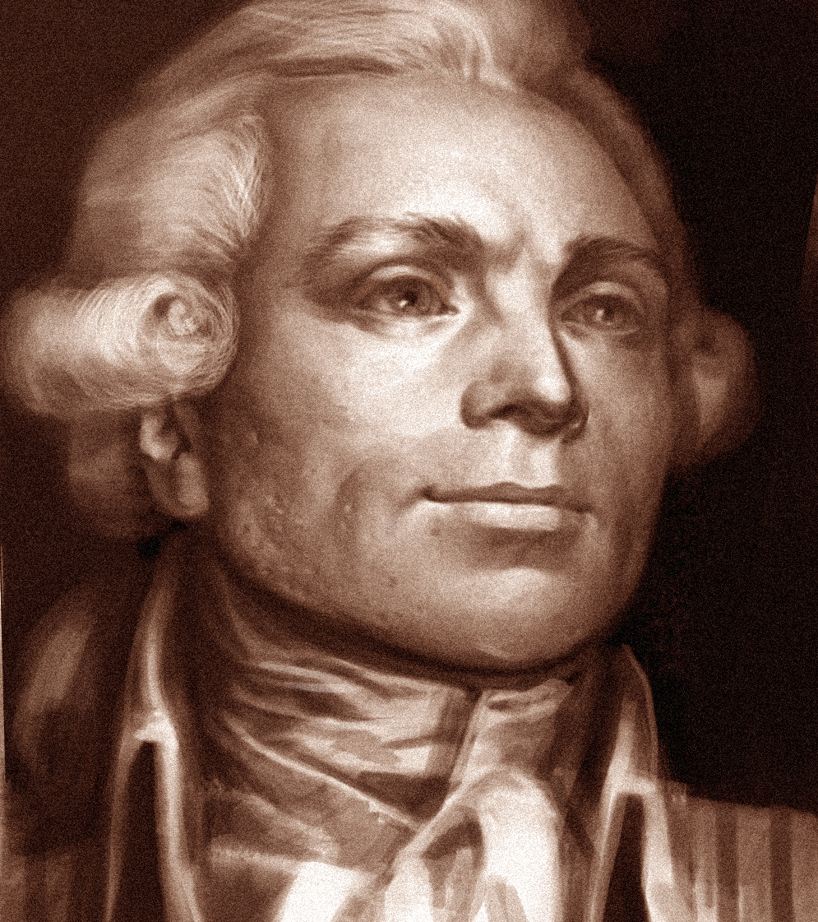
Robespierre
Believed deeply in France and the Revolution
He would protect both at ALL COSTS
Anyone who challenged the him or threatened the revolution was executed via guillotine.
Anywhere from 30,000-40,000 people were executed during the Reign of Terror.
Country was modernized, metric system introduced, army made more efficient, new schools and universities built.

Slide 11
Robespierre
Government tried to solve the problem of famine by introducing state-controlled bread prices.
Government confiscated grain from the countryside to control food supply and feed cities.
Robespierre eventually began to lose control.
His own Committee of Public Safety began to question him. Feared Dictatorship.
Failed attempt to shoot himself
He was eventually arrested and guillotined in 1794

Slide 12
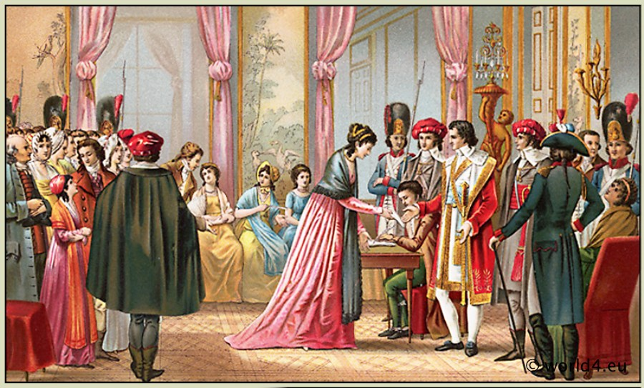
The directory
https://www.youtube.com/watch?v=PyZsLYxaIuM
In October 1795, Members of the National Convention (the governing body at this time) reorganized government YET AGAIN
They created the Directory
The directory gave power to people who owned property.
They hoped to copy the American and British Models
This unfortunately… ended the days of equality…
Many of advances made for poor were swept away

Slide 13
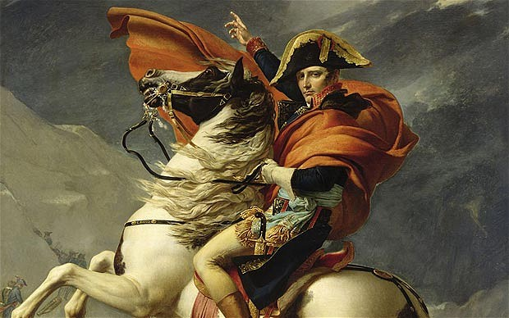
Napoleon Bonaparte
In 1799, Napoleon Bonaparte overthrew (coup d’etat) the Directory and became the first Consul of France.
People had been generally unhappy with the Directory and their failures at war with other countries (the directory was weak from repeated defeats)

